Slide 1
ME321: Lecture Room Chairs
Stephen Wildish
Justin Palpant
Kunyao Yu

Slide 2
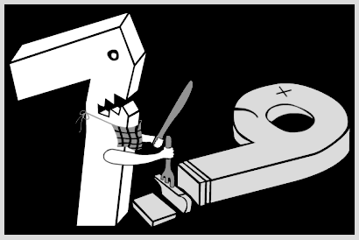
Seven8Nine Inc
Where no problem is too big to tackle.
www.sodahead.com

Slide 3
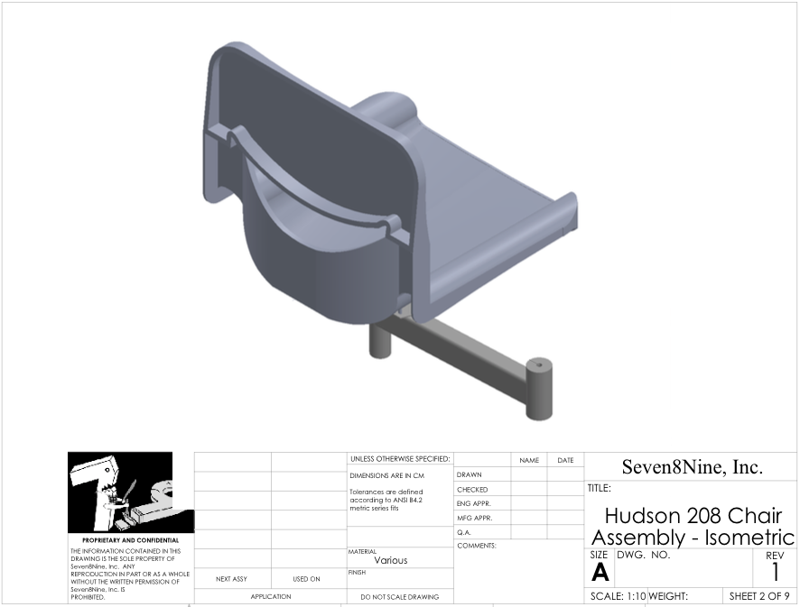
Full Assembly

Slide 4
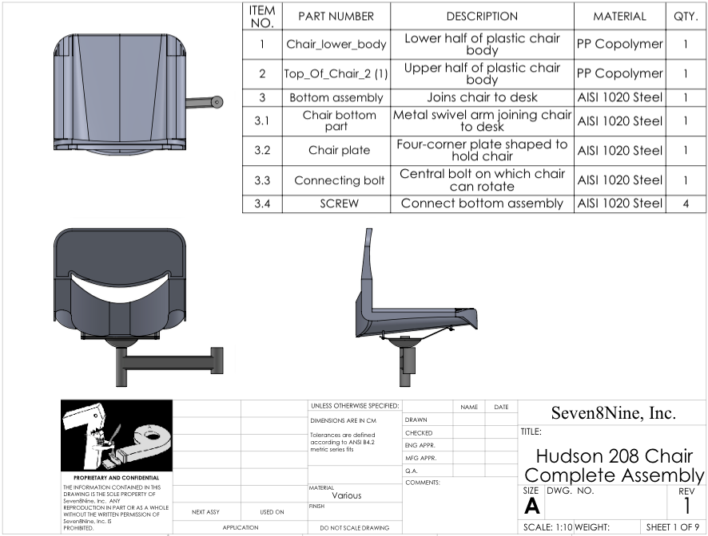
Full Assembly

Slide 5
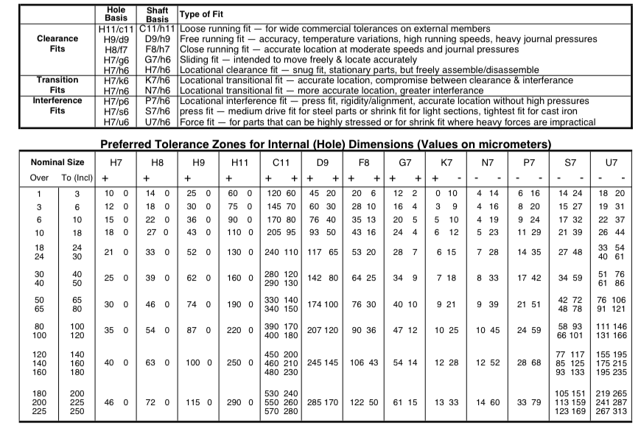
ANSI B4.2 Fit Chart 1

Slide 6
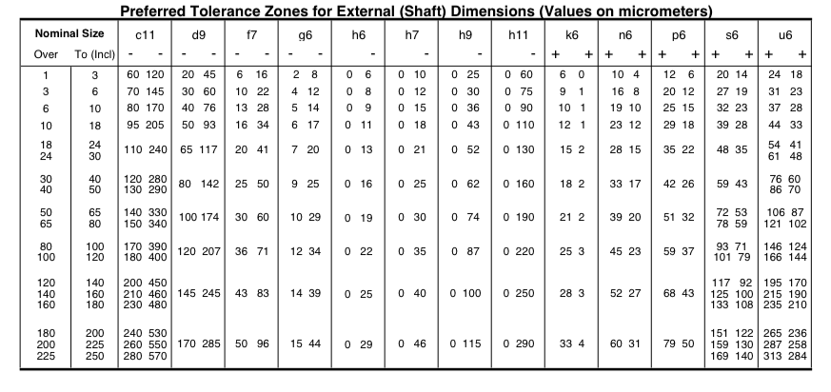
ANSI B4.2 Fits Chart 2

Slide 7
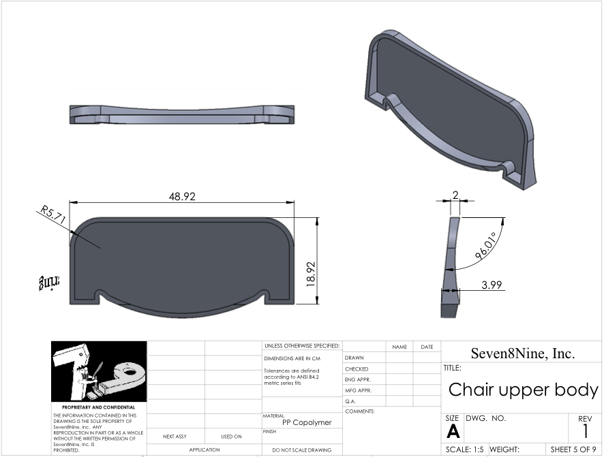
Chair – Top Half

Slide 8
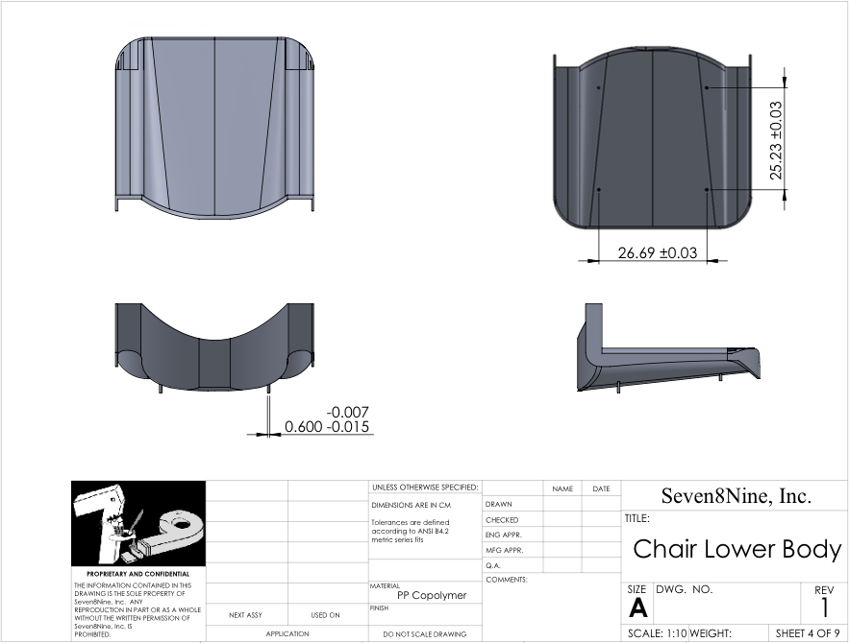
Chair – Bottom Half

Slide 9
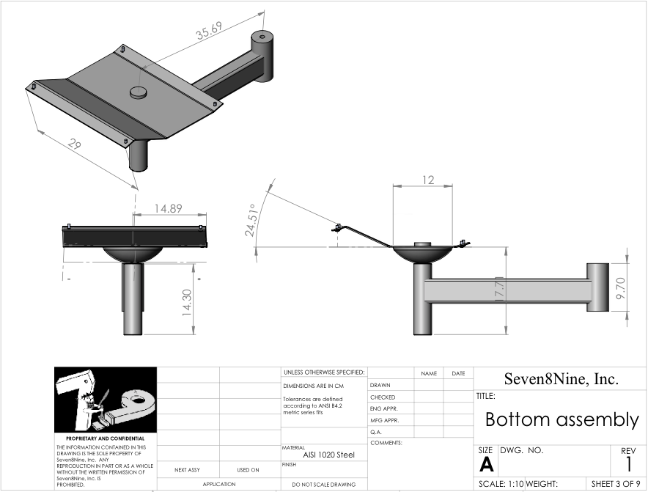
Support – Assembly

Slide 10
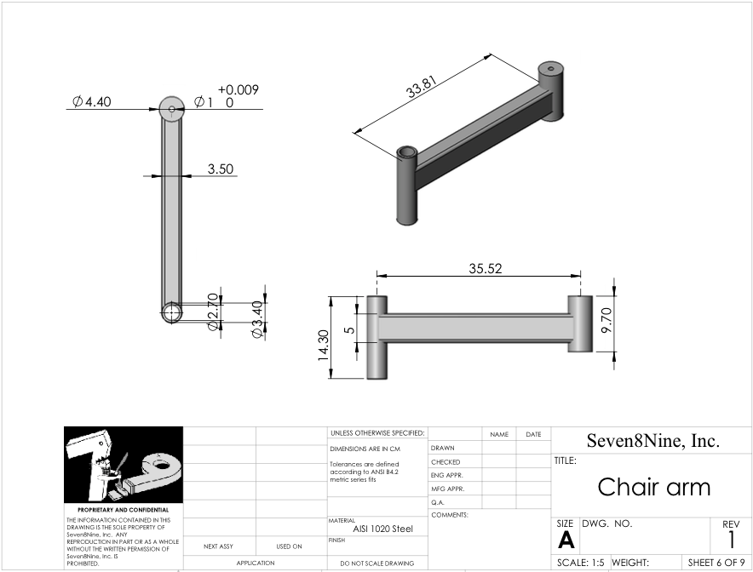
Support – Arm

Slide 11
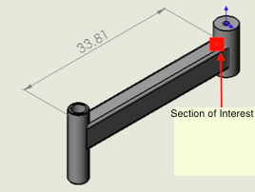
Back of Envelope Calculations
Cross section is a 3.5cm x 5cm rectangle
Force due to 185 lbs person and 10 lbs chair
Stress due to bending is 191.1 kPa

Slide 12
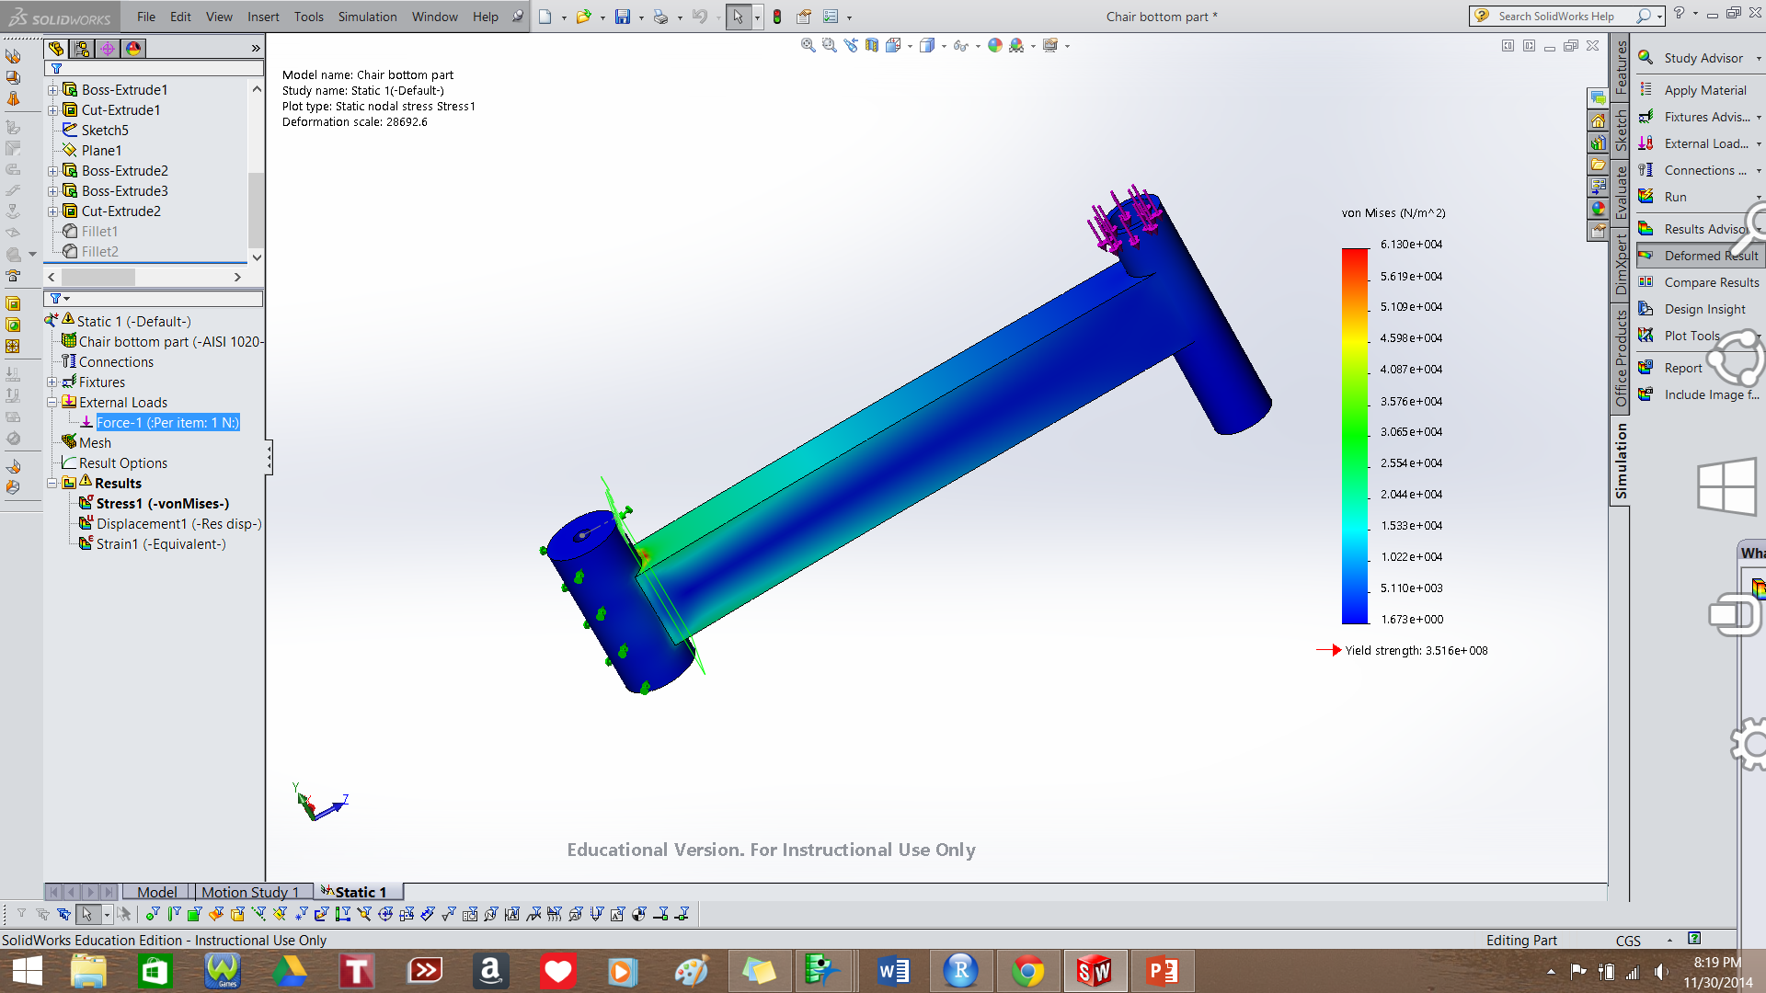
Stress Analysis – Bar
Max stress is approximately 61.3 KPa

Slide 13
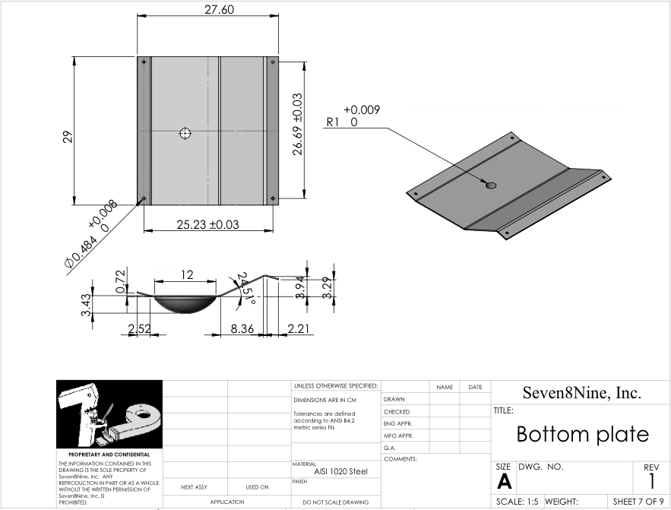
Support – Bottom Plate

Slide 14
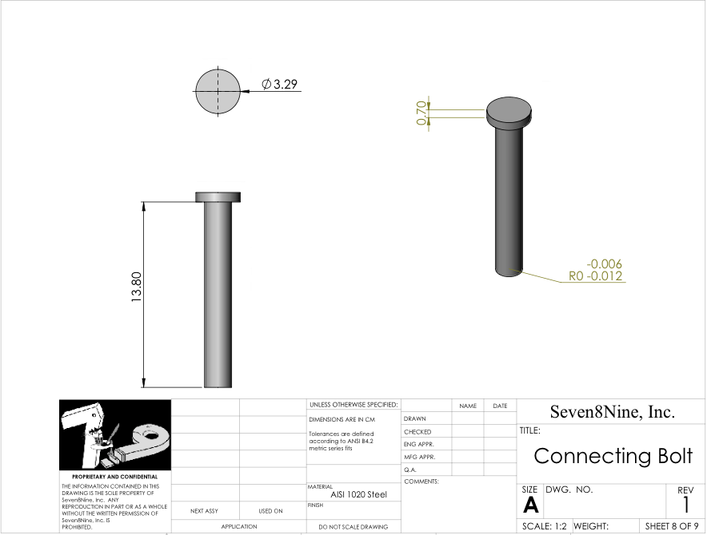
Support – Bolt

Slide 15
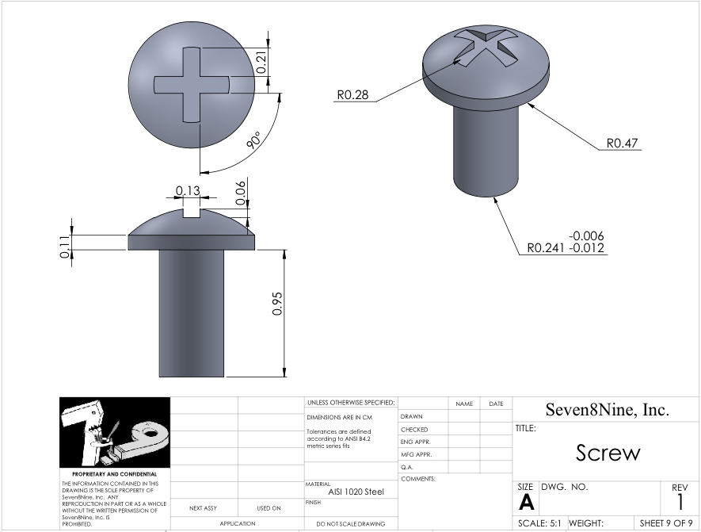
Support – Screw

Slide 16
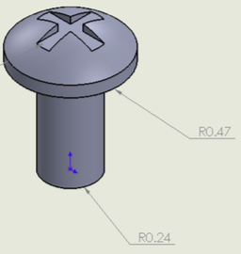
Back of Envelope Calculations
Radius is 0.24 cm
Weight evenly distributed among four screws
Force due to 185 lbs person and 10 lbs chair
Compressive stress is 11.99 MPa

Slide 17
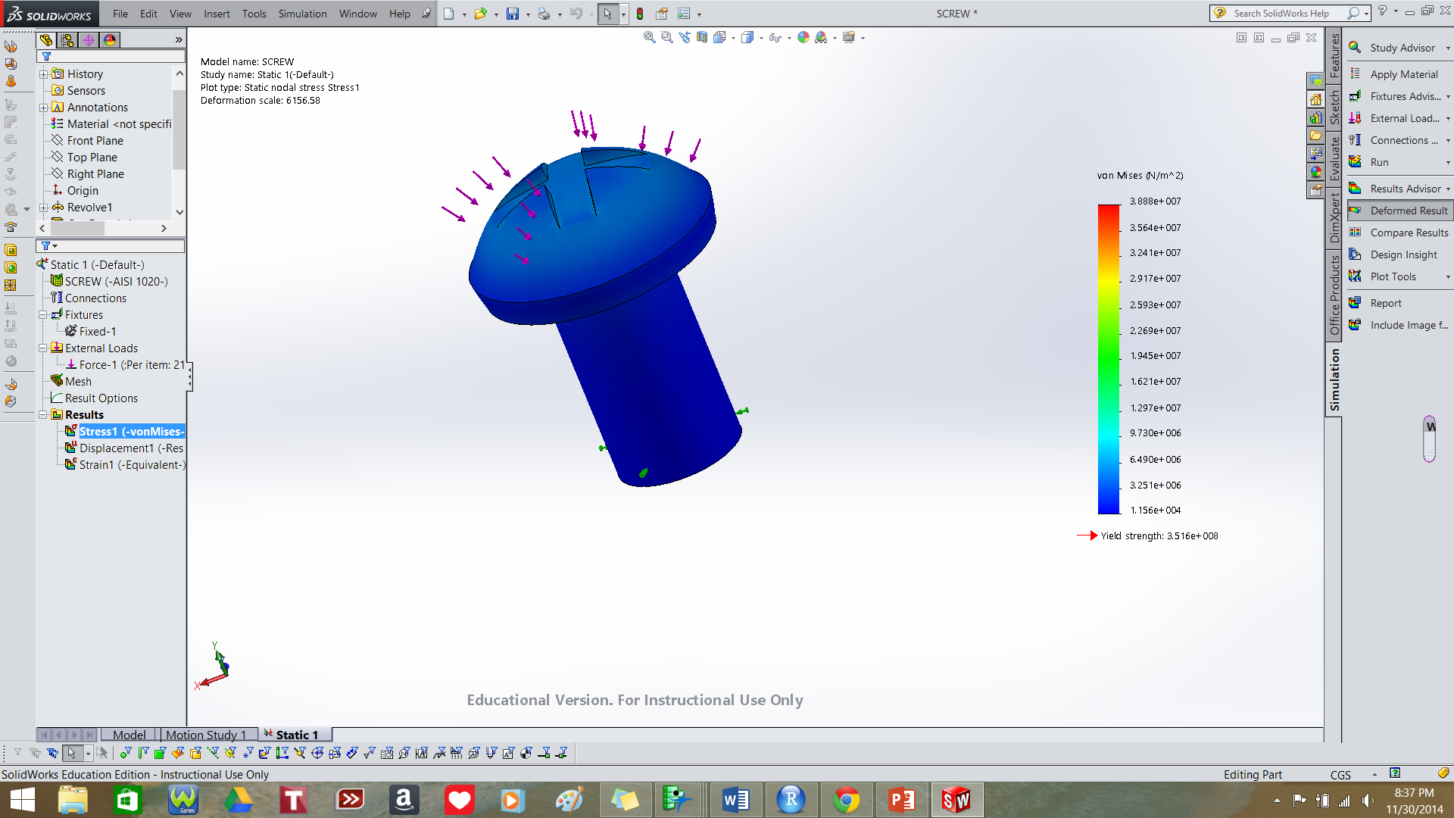
Stress Analysis – Screw
Max stress is approximately 38.88 MPa along edge where cylinder and bolt top are joined

Slide 18
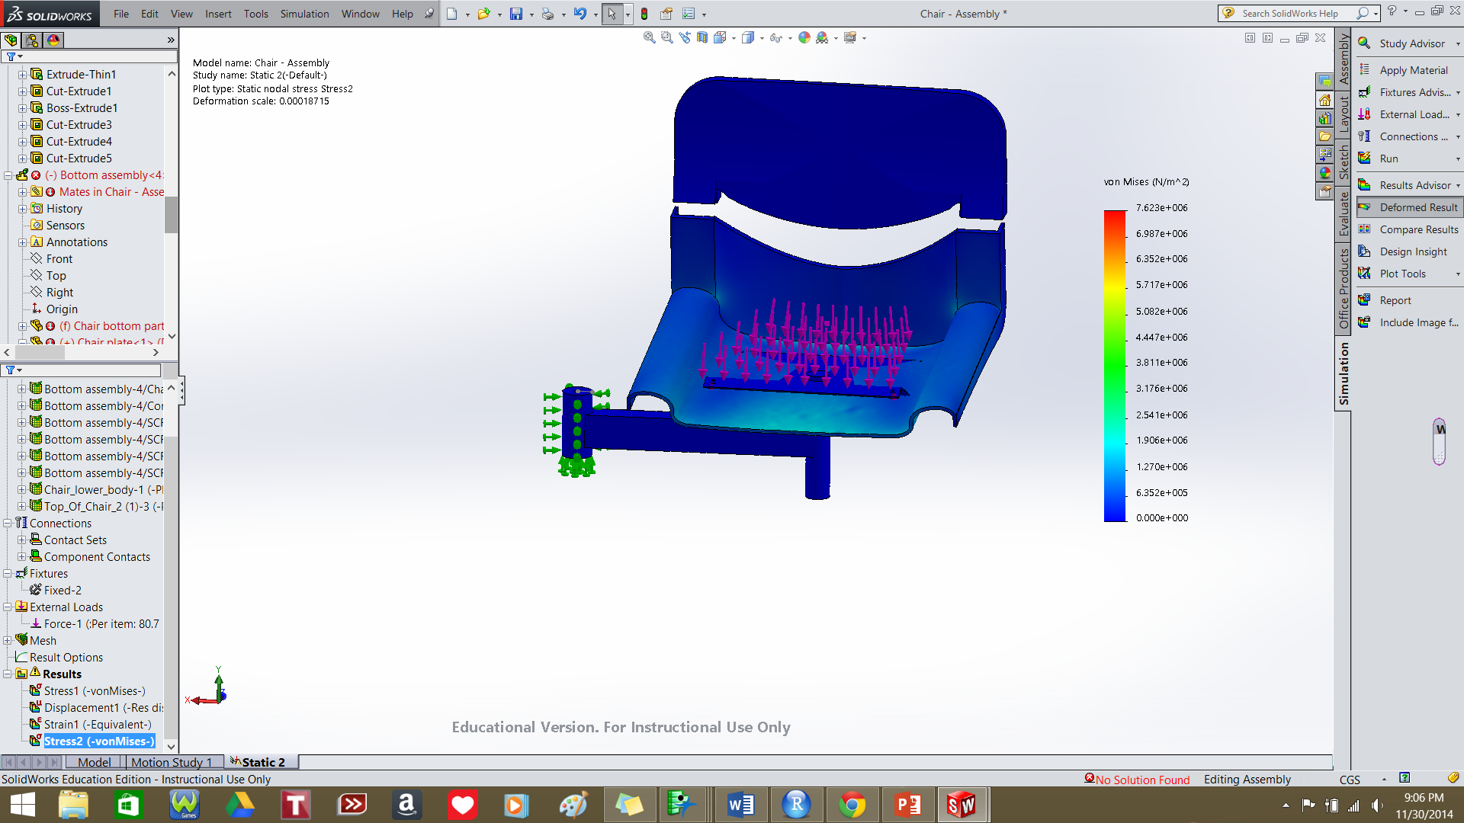
Stress Analyses – Assembly (1)

Slide 19
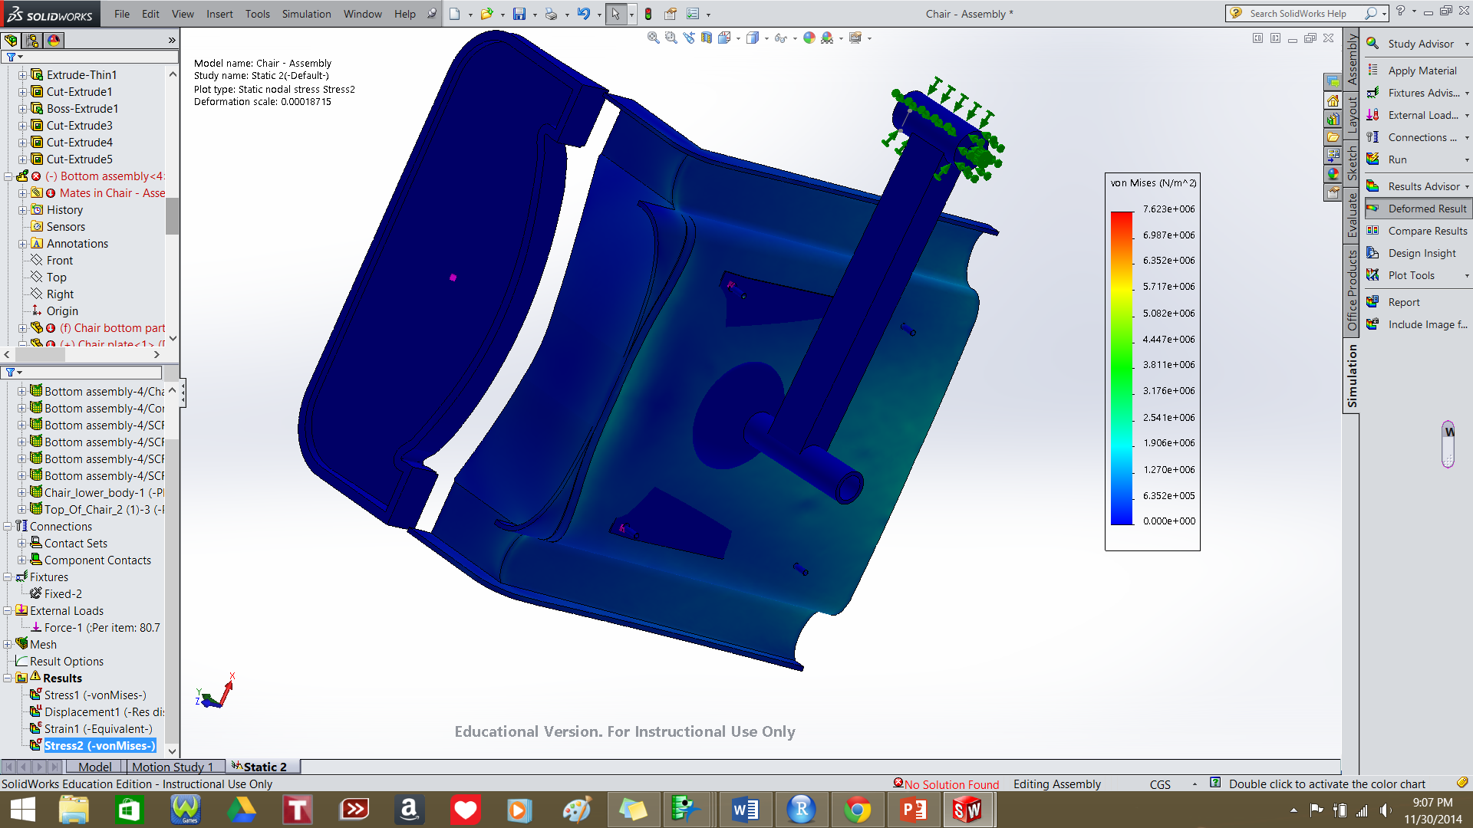
Stress Analyses – Assembly (2)
Max stress is approximately 7.62 MPa, located at the cylindrical shells for connecting screws

Slide 20
Thank you!

